Slide 1

Week 1 Internship Report
Computer Networking Fundamentals
Submitted By :
Name: Krina Sorathiya
Internship: DG Interns Hub
Week: 4

Slide 2
Introduction
Network security is the practice of protecting computer systems, devices, services, and network traffic from unauthorized access, misuse, disruption, and data loss. It involves implementing appropriate security measures to protect network resources and maintain the confidentiality, integrity, and availability of information.
Security testing in a controlled laboratory environment helps learners understand how systems communicate and how potential weaknesses can be identified before they are exploited. It also provides practical knowledge of network scanning, service identification, and traffic analysis.
In this Week 4 practical, a small isolated lab network was designed using virtualization. Kali Linux was used as the attacker and security-testing machine, while a Windows or Linux virtual machine was configured as the target. A web server was installed and configured on the target system. Nmap was then used to identify open ports and running services, while Wireshark was used to capture and analyze network traffic such as HTTP, DNS, and ICMP.
The practical activities provided hands-on experience in understanding network exposure, identifying potential security risks, and applying basic security recommendations in a controlled environment.

Slide 3
Lab Environment and Network Topology
Component | Role | Example
Kali Linux | Attacker / Security Testing | Nmap, Wireshark
Windows/Linux | Target | Apache/Nginx Web Server
VirtualBox/VMware | Virtualization Platform | Host-only / Internal / NAT lab network
Kali Linux ───── Virtual Lab Network ───── Target Windows/Linux
Both machines must have compatible network settings and be able to communicate. Record the actual IP addresses used in the lab from your own environment.

Slide 4
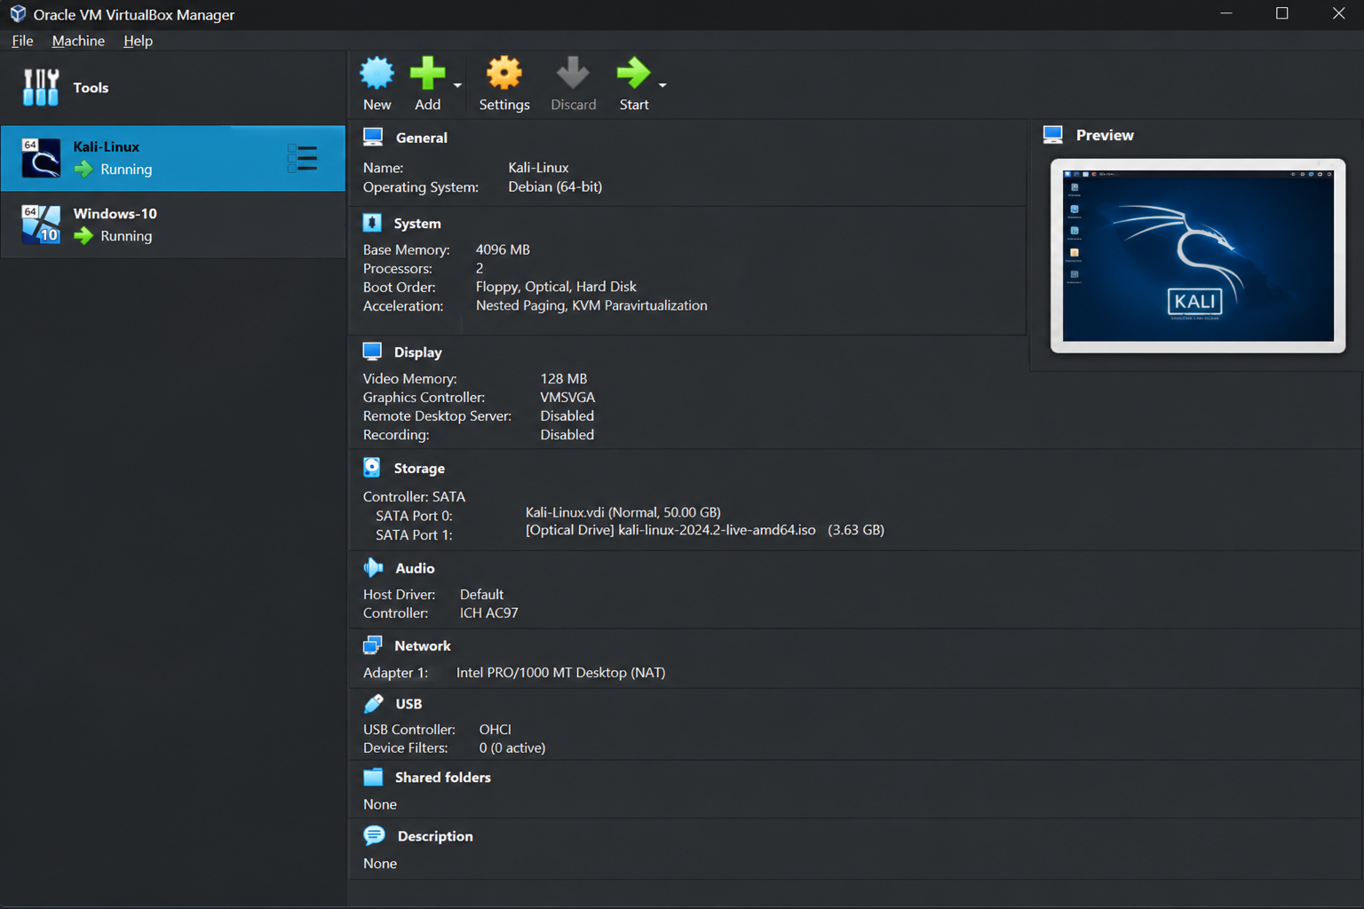
Virtual Machines

Slide 5
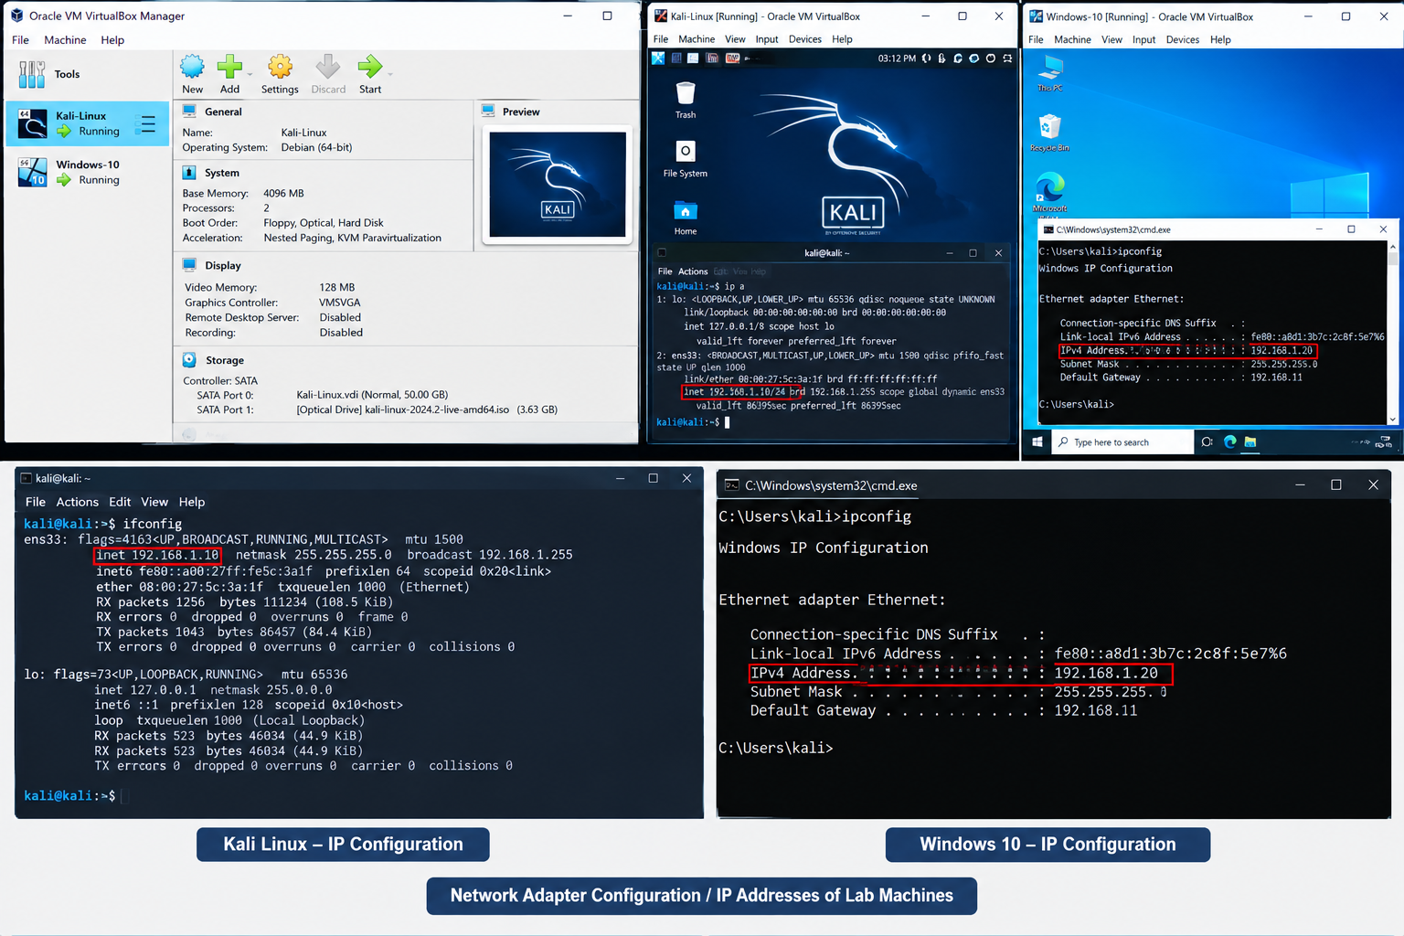
Network Configuration

Slide 6
Setup Basic Network
A small virtual network was created to allow controlled communication between the attacker and target machines.
Step-by-Step Procedure:
Open VirtualBox or VMware.
Kali Linux is configured as the attacker machine.
Create or select a Windows/Linux VM as the target.
Configure both network adapters so that the machines can communicate on the same lab network.
Start both machines.
Check the IP address on the target machine.
From Kali, test connectivity to the target using ping.
Confirm that communication is successful before starting security testing.
ip addr
ping <TARGET-IP>
The exact IP address should be taken from the student's own lab. Successful ping confirms basic connectivity when ICMP is permitted.

Slide 7
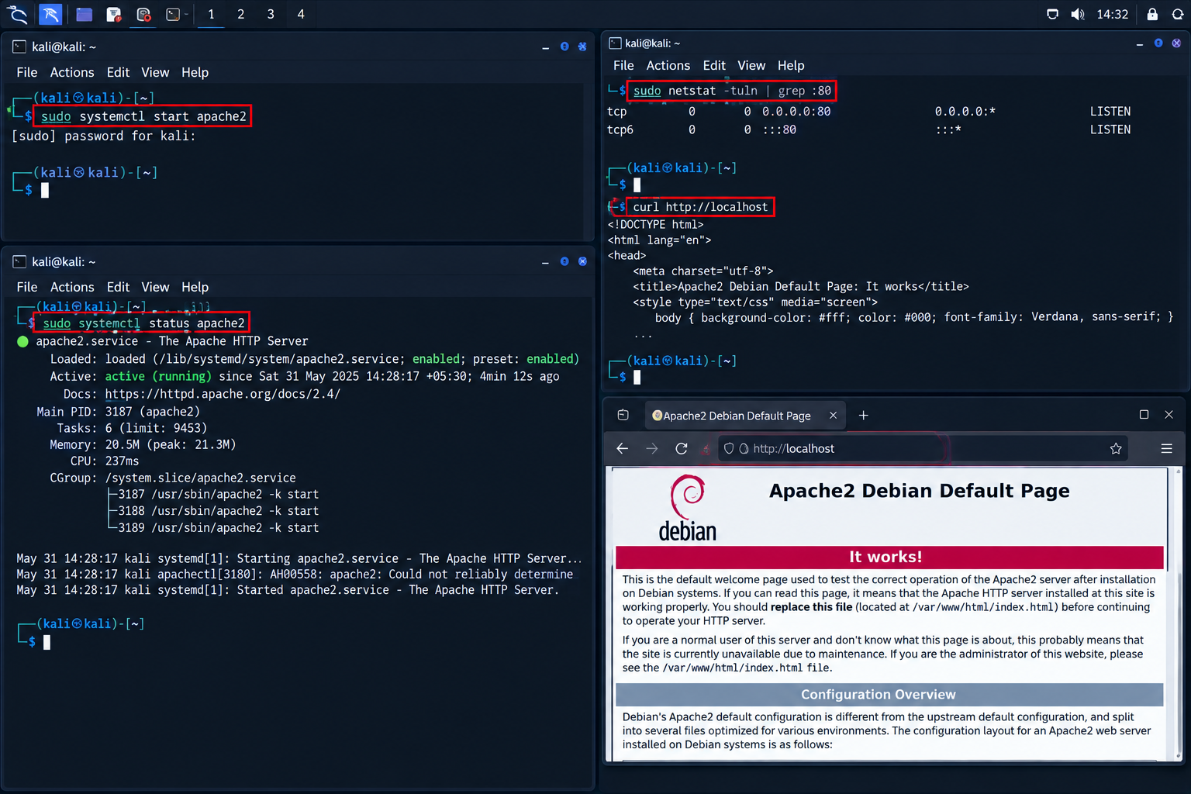
Kali IP / Connectivity

Slide 8
Install and Configure Web Server
A basic web service was configured on the target machine. Apache or Nginx can be used depending on the operating system. The objective is to create a service that can later be discovered through Nmap and observed through Wireshark.
Linux – Apache Example
sudo apt update
sudo apt install apache2 -y
sudo systemctl start apache2
sudo systemctl enable apache2
sudo systemctl status apache2
After the service starts, open the target IP address in a browser from the lab network.
Verification
Confirm the web server service is active.
Open the target IP in a browser.
Verify that the default web page or configured test page loads.
Record the service port, normally HTTP port 80 when configured with default settings.

Slide 9
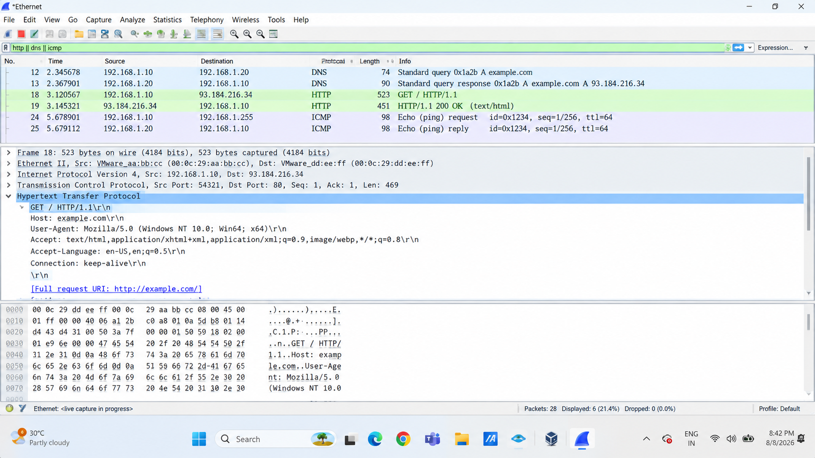
Web Page

Slide 10
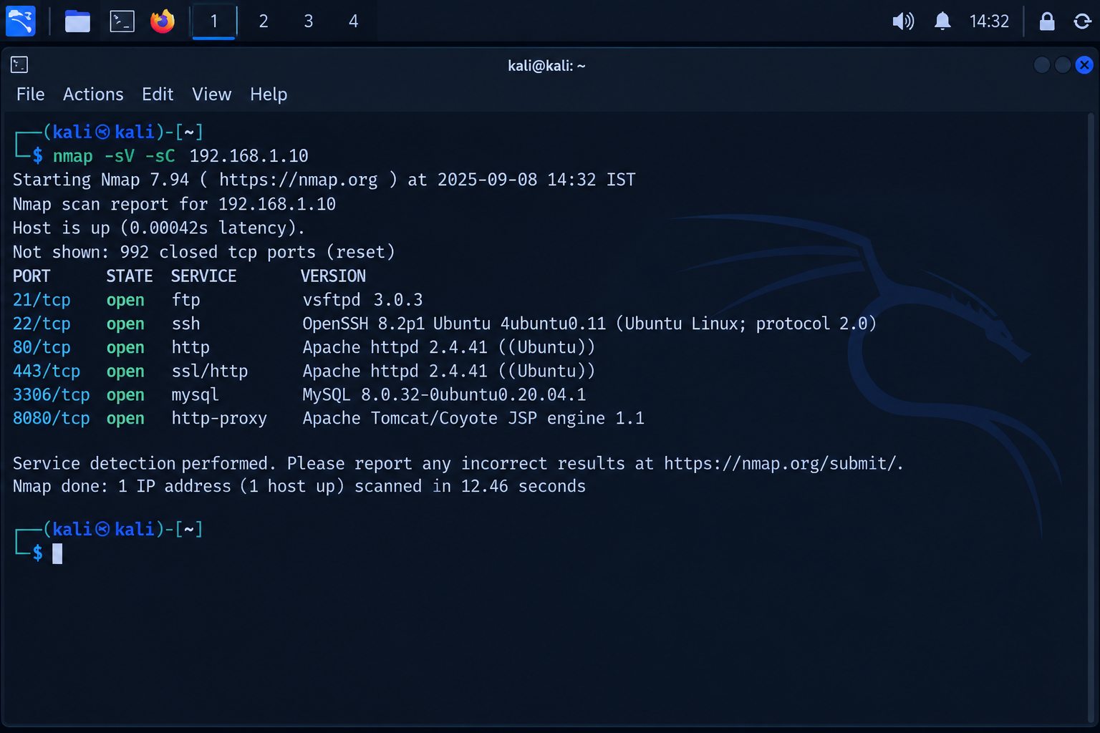
Network Scanning Using Nmap
Nmap is a network discovery and security auditing tool. In this practical it is used only against the authorized lab target. The scan helps identify open ports and the services associated with them.
5.1 Basic Scan
nmap <TARGET-IP>
This scan provides an initial list of discovered ports and their states.

Slide 11
Nmap Result Analysis:
Port | State | Service | Observation
21/tcp | Open | FTP | FTP service vsftpd 3.0.3 is running. FTP may transmit data without encryption.
22/tcp | Open | SSH | OpenSSH 6.6.1p1 is detected. It provides remote administration access.
25/tcp | Open | SMTP | Postfix SMTP service is running for email communication.
53/tcp | Open | DNS | ISC BIND 9.9.5 is detected as the DNS service.
80/tcp | Open | HTTP | Apache 2.4.7 web server is running and serving HTTP traffic.
111/tcp | Open | RPCBind | RPCBind is running and provides port-mapping functionality for RPC services.
443/tcp | Open | HTTPS | Apache 2.4.7 is providing HTTPS/SSL web service.
3306/tcp | Open | MySQL | MySQL 5.5.60 database service is externally accessible.
8080/tcp | Open | HTTP-Proxy | Apache Tomcat/Coyote JSP Engine 1.1 is detected on the alternate web application port.

Slide 12
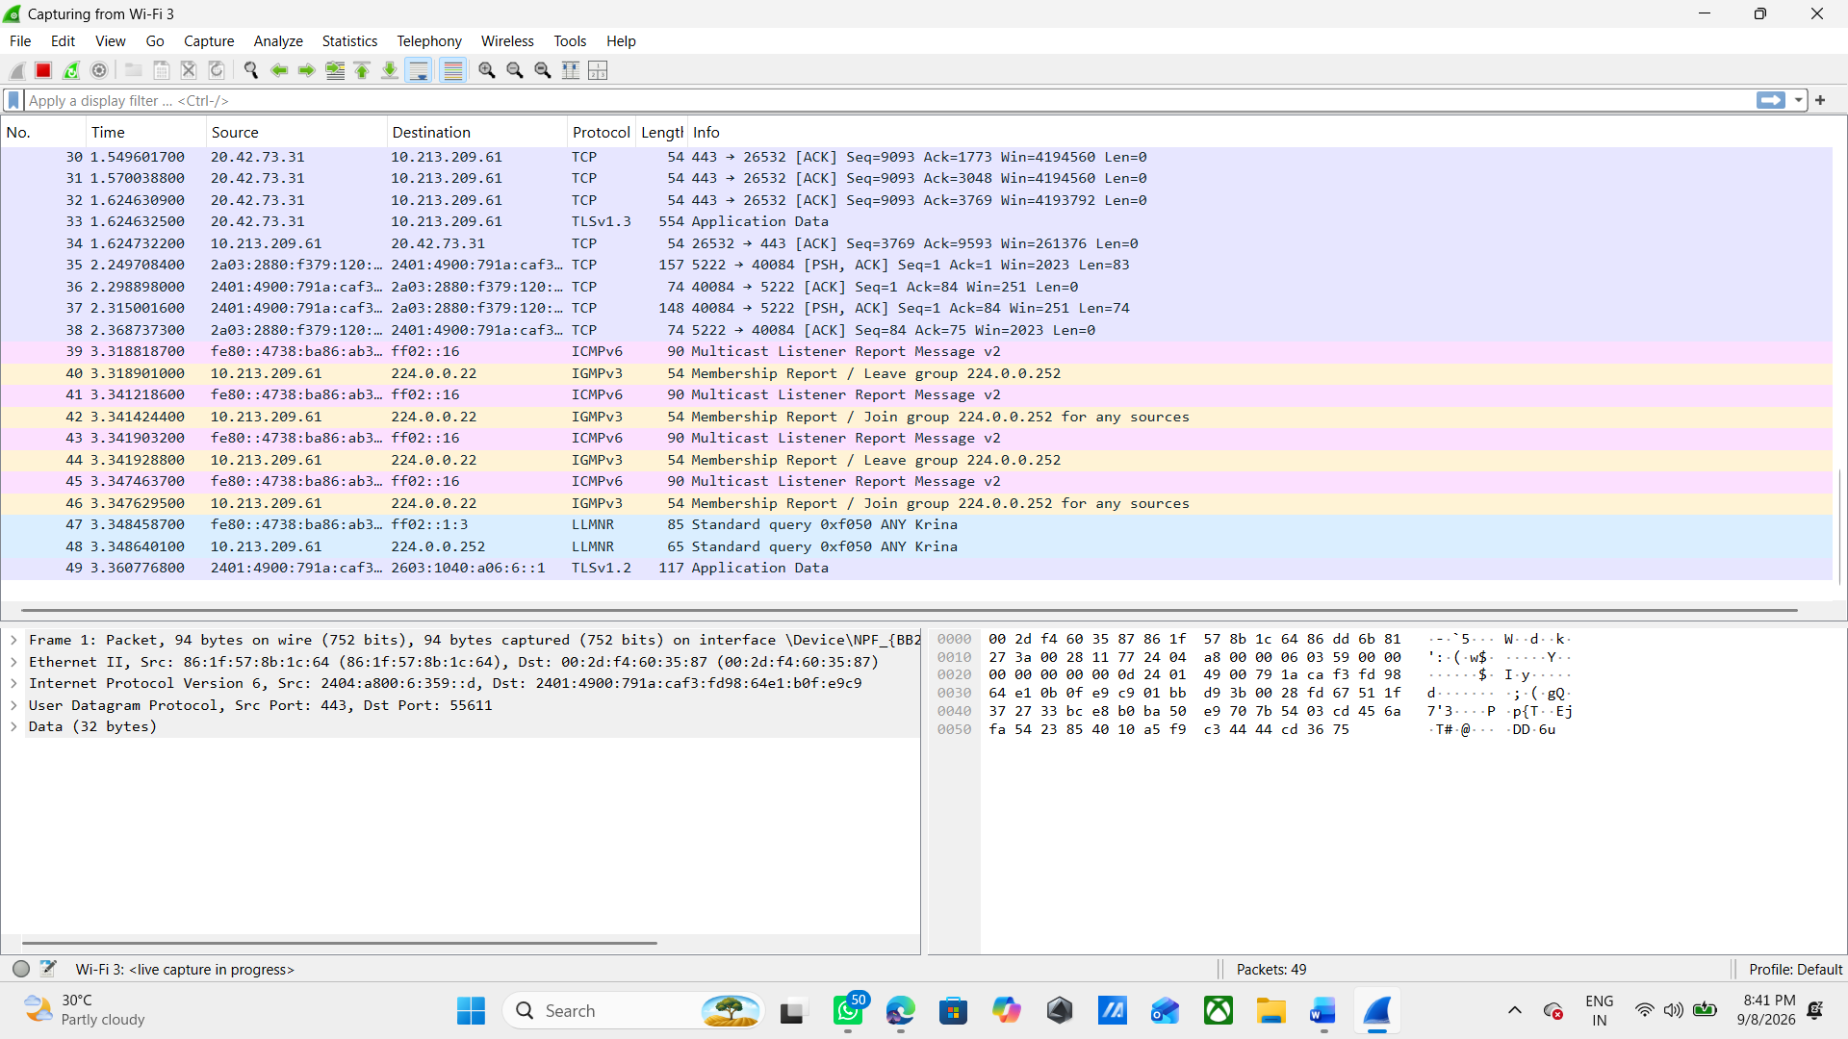
Traffic Analysis Using Wireshark:
Wireshark is a packet-analysis tool used to capture and inspect network traffic. It can show communication details such as source and destination addresses, protocols, ports, packet timing and protocol fields.
6.1 Start Capture:
Open Wireshark on the appropriate lab interface.
Select the interface connected to the lab network.
Start packet capture.
Generate traffic from the lab machines, such as ping or opening the web page.
Stop the capture after enough packets are collected.
Apply display filters to focus on specific protocols.

Slide 13
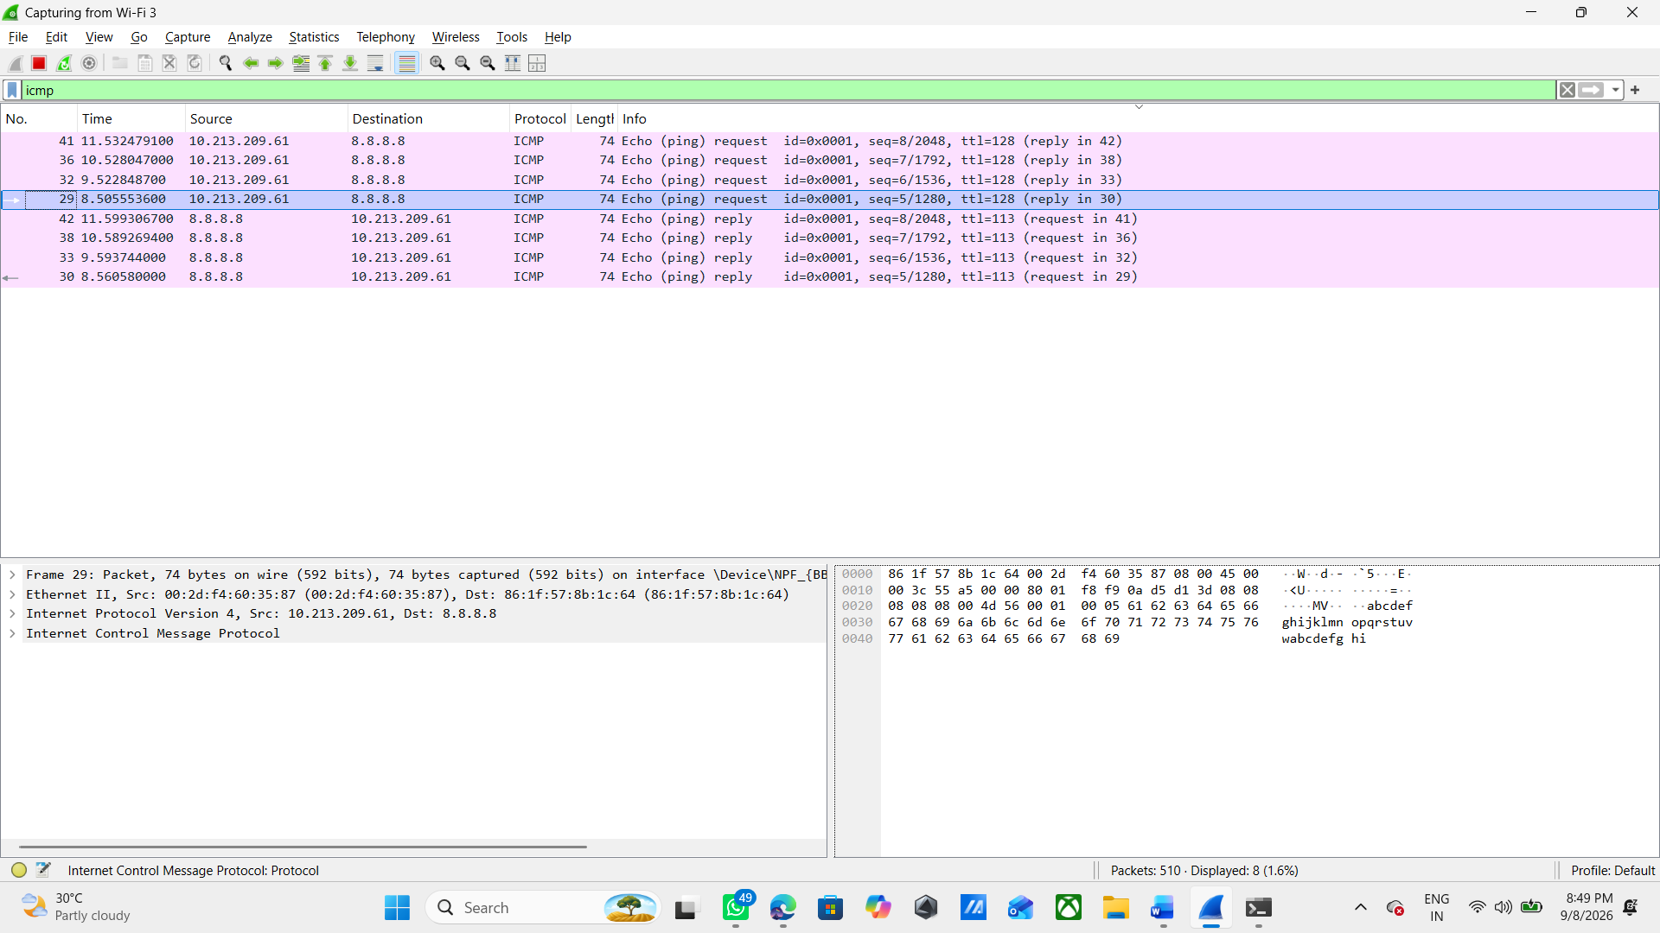
ICMP Analysis
icmp
ICMP packets can be observed when the lab machines use ping. An ICMP echo request is sent by the source and an echo reply may be returned by the destination when permitted.

Slide 14
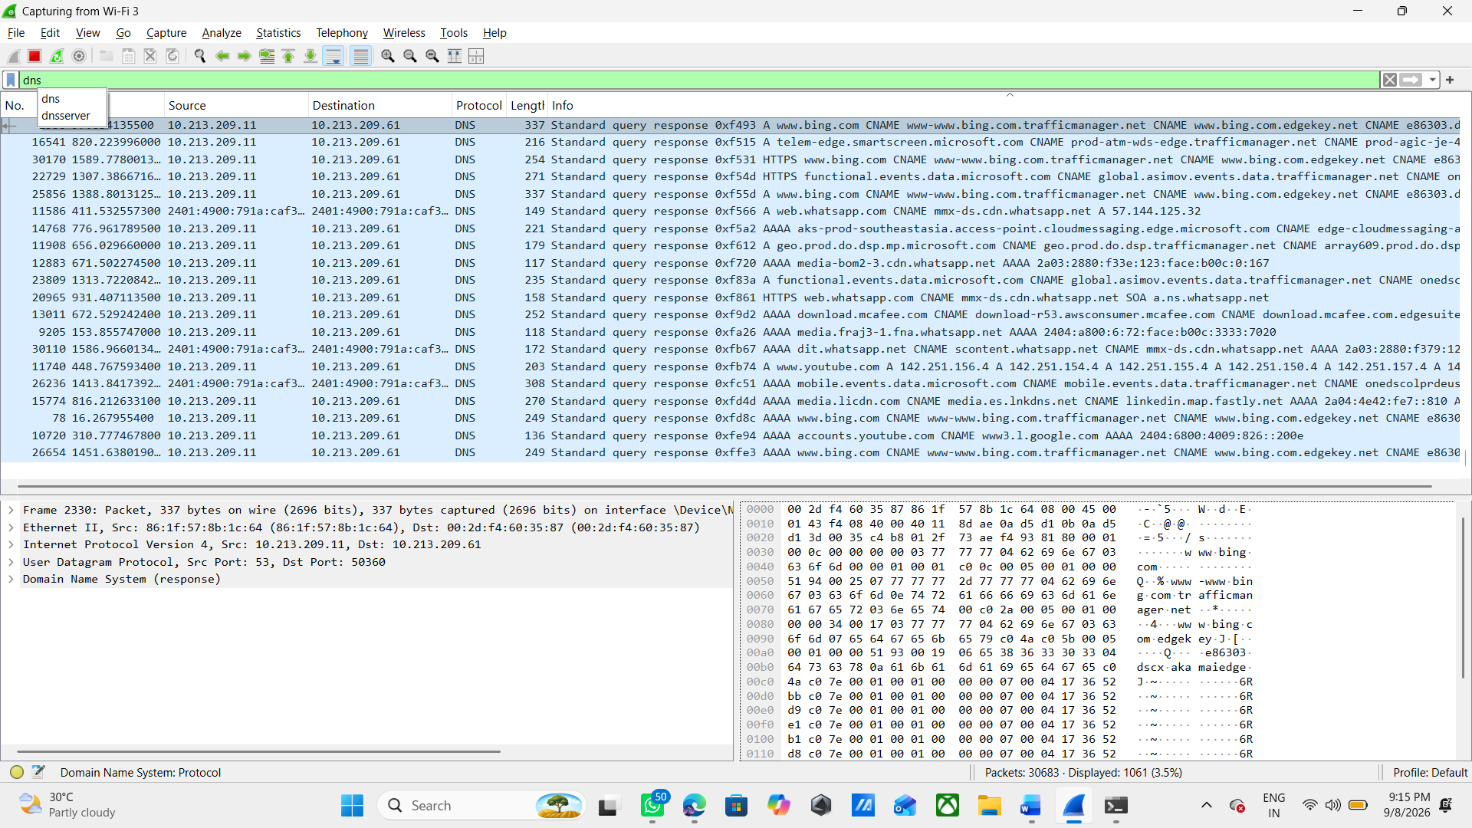
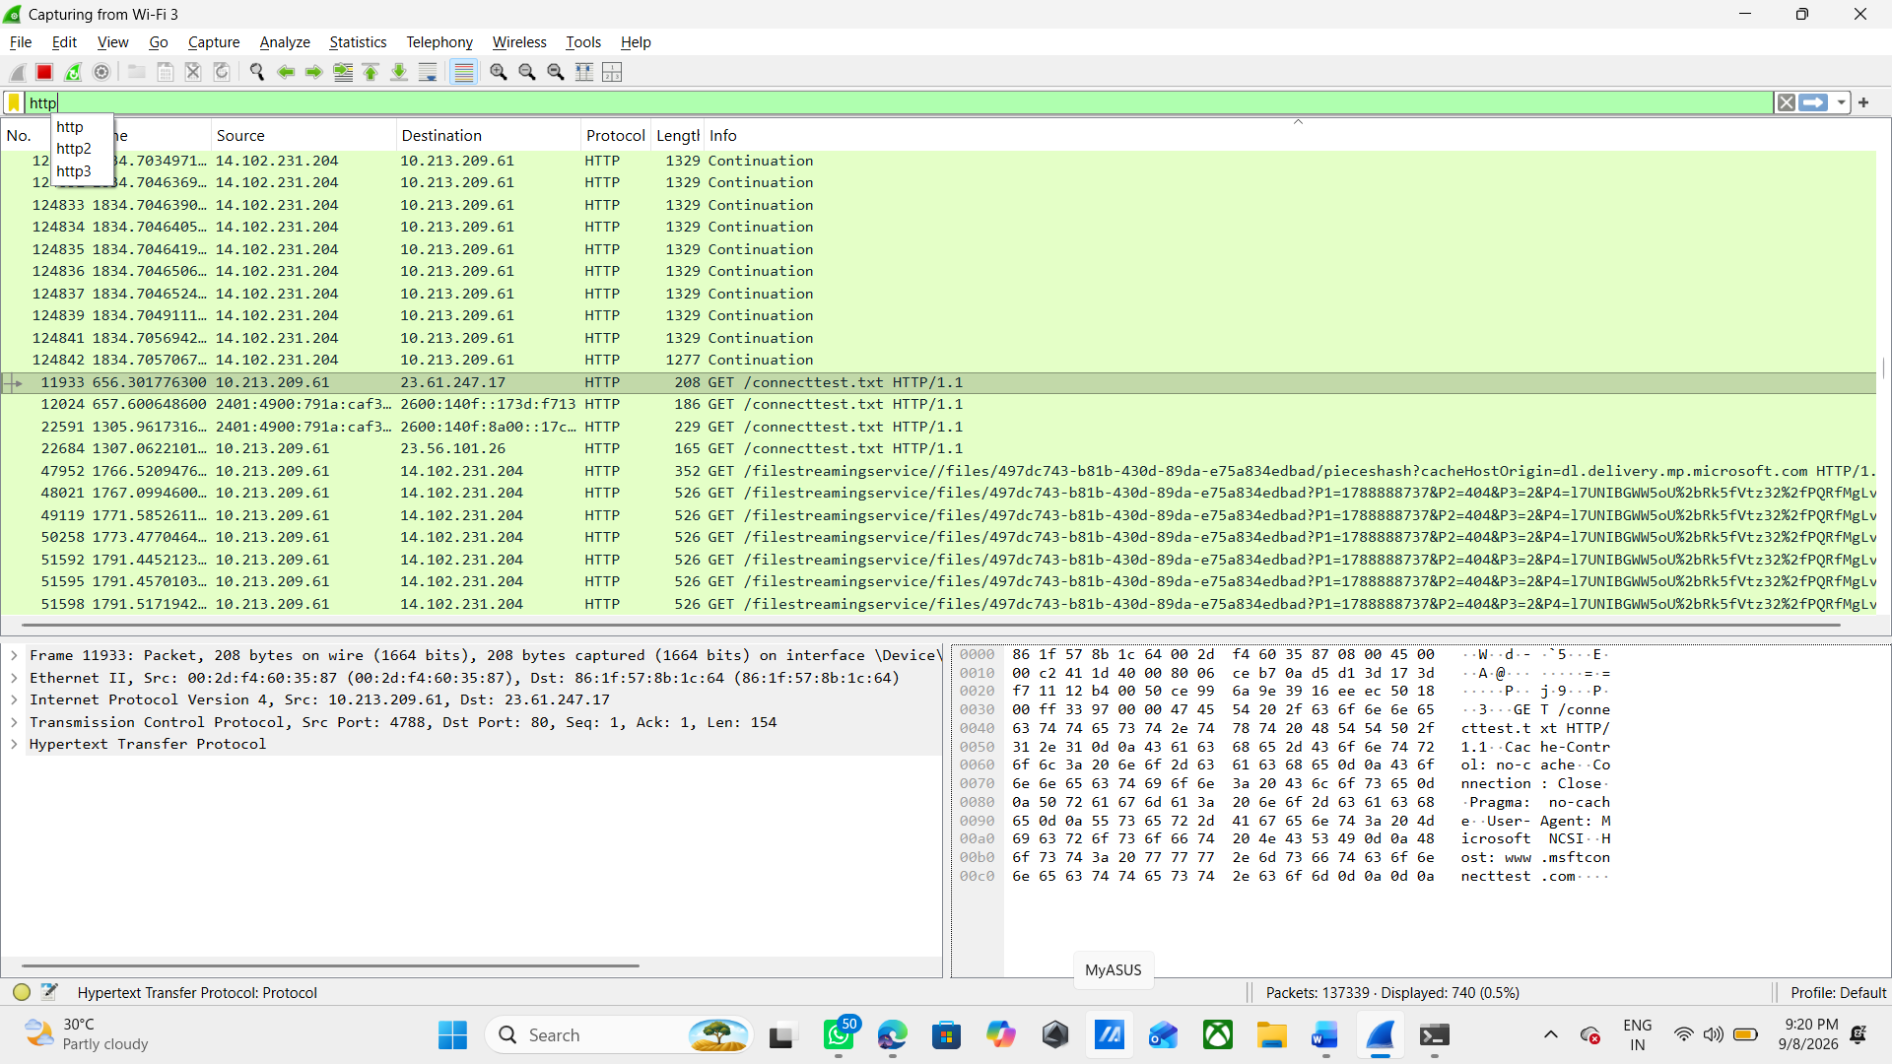
DNS Packets & HTTP Packets

Slide 15
Complete Security Testing Workflow:
The complete workflow combines network setup, service deployment, scanning and packet analysis.
Step 1 – Build the isolated virtual lab.
Step 2 – Connect attacker and target to the same virtual network.
Step 3 – Verify connectivity.
Step 4 – Install and start the web server on the target.
Step 5 – Confirm the web service is accessible.
Step 6 – Scan the target with Nmap.
Step 7 – Record open ports and running services.
Step 8 – Capture network traffic using Wireshark.
Step 9 – Filter ICMP, DNS and HTTP traffic where available.
Step 10 – Compare scan results with observed network activity and document findings.

Slide 16
Security Observations:
Open ports represent network-accessible services and should be limited to what is required.
Service/version information can help security teams identify software that needs patching or review.
Web services should be configured securely and unnecessary services should be disabled.
Packet captures can reveal communication patterns, protocol usage and troubleshooting information.
Security testing must remain within the authorized lab scope.

Slide 17
Findings and Analysis
ID | Finding | Evidence | Risk | Recommendation
F-01 | Multiple unnecessary/exposed services are accessible, including FTP (21/tcp), SMTP (25/tcp), RPCBind (111/tcp), MySQL (3306/tcp), and Tomcat (8080/tcp). | Nmap scan screenshot showing open ports | High | Close unnecessary services and restrict required services using firewall rules and network access controls.
F-02 | Several service versions were identified, including vsftpd 3.0.3, OpenSSH 6.6.1p1, Apache 2.4.7, MySQL 5.5.60, and BIND 9.9.5. Some versions appear outdated. | Nmap -sV scan screenshot | Medium | Patch and update outdated software to supported versions and minimize exposed version information where appropriate.
F-03 | Network traffic should be reviewed to identify whether sensitive communication is being transmitted using insecure or improperly configured protocols. | Wireshark screenshot showing captured HTTP/DNS/ICMP traffic | Medium | Use secure protocols and appropriate encryption/configuration where applicable. Restrict or disable insecure services when they are not required.

Slide 18
Learning Outcomes:
Understood how to create a small controlled virtual security lab.
Learned the purpose of attacker and target machines in a security-testing environment.
Learned how to deploy and verify a basic web service.
Learned how Nmap identifies exposed ports and services.
Learned how Wireshark captures and filters network packets.
Understood basic HTTP, DNS and ICMP traffic patterns.
Improved practical skills in collecting evidence and documenting security observations.
Understood the importance of authorization and safe testing.

Slide 19

Thank you

